Slide 1

What’s This Thing Called SRE?
Ashley Poole
@AshleyPooleUK

Slide 2
Introductions
Software Developer @ Proto Labs
SRE & DevOps Junkie
Co-organiser of @ShropshireDevs user group
Notes:
Over 5 & half years at Proto Labs in various IT and Software roles. Previously the “IT” guy doing networking, sysadmin, etc.

Slide 3
First let’s back up a minute...
Notes:
Before we jump into SRE, let’s look at something else first to give us a good grounding to understand SRE.

Slide 4
And talk about DevOps!
Notes:
Yes, I’m going to talk about DevOps in a SRE talk.

Slide 5
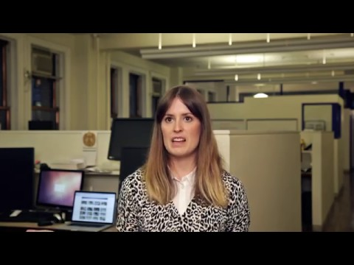
http://vooza.com/videos/what-is-devops/

Slide 6
DevOps Is Not:
A Role
A Team
A Tool
One strategy fits all
Only for startups or “unicorn” companies
Notes:
A Team - is not just a collection of Ops and Dev staff put together.
Last two points apply to SRE too as we’ll come to see.

Slide 7
DevOps Is:
A culture
A set of principals
A willingness to break down silos
An agile relationship between Development and IT Operations
Enabling a feedback loop!
Notes:
A Team - Nor a collection of Ops and Dev staff put together

Slide 8
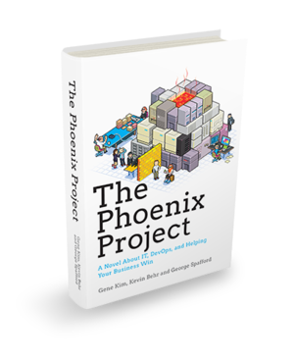
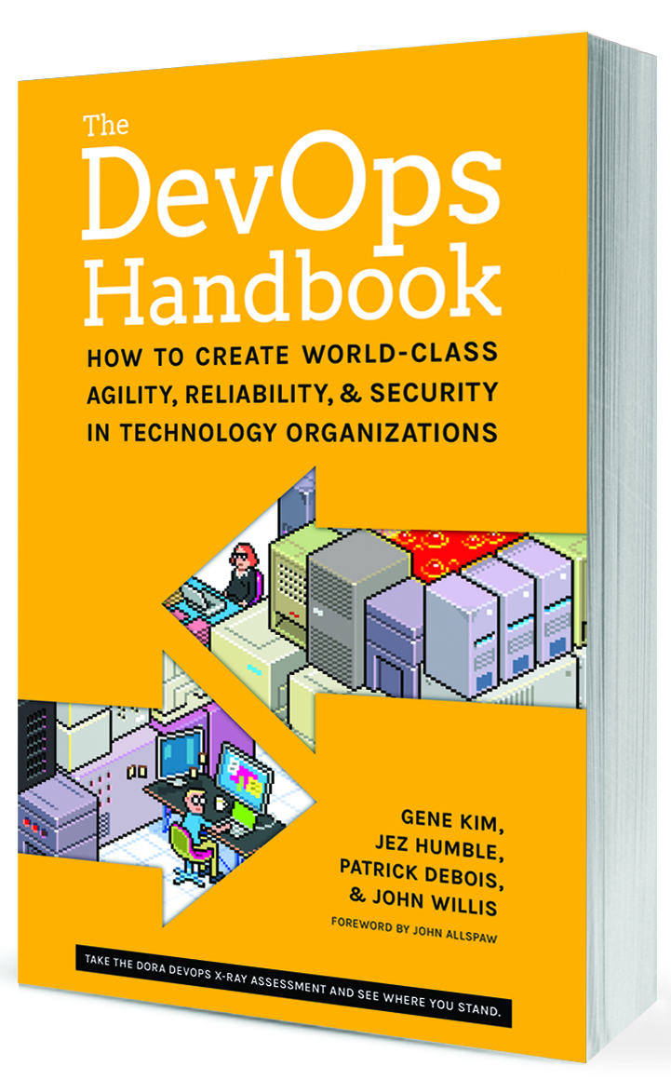
Notes:
The Phoenix Project, published in January 2013. Novel format of an IT and software team trying to launch a new ecommerce platform.
DevOps handbook, published in October 2016.
Follows in the footsteps of The Phoenix Project, The DevOps Handbook shows how to replicate these incredible outcomes, by showing how to integrate Product Management, Development, QA, IT Operations, and Information Security to elevate your company and win in the marketplace.

Slide 9
Now, what is SRE?

Slide 10


SRE != Sex and Relationships Education

Slide 11


SRE != Special Religious Education

Slide 12

SRE = Site Reliability Engineering
Notes:
Born out of Google in 2003.
Term coined by Ben Treynor, the senior VP of technical operations at Google.
Could be viewed as an implementation of DevOps but with it’s own views on certain items as we’ll come to see.
Implemented as Site Reliability Engineers
Think of SRE as an kind of implementation of DevOps

Slide 13
What is a Site Reliability Engineer (SRE)?
Notes:
SREs run services, operated for users and are ultimately responsible for the health of those service. It takes a lot to keep these running which we’ll get to shortly.
Foremost they are a Developer for the most part. Hiring process and skills are the same as a developer, except SRE have infrastructure knowledge too.
A coding background is critical.
They are not a system administrator, operations engineer or DevOps engineer.
Someone who automates their mundan or manual work loads and fix root causes in applications.

Slide 14
“Site Reliability is what happens when a software engineer is tasked with what used to be called operations”
- Ben Treynor

Slide 15
How do SREs operate?
Notes:
They are embedded into product teams. Built it, Own it teams. Reduce hands offs to operations and historically DevOps.
They are part of the developer head count for product teams.
They have a hard limit of < 50% of time doing operational work such as fire fighting. Also called Toil - toil is mundane, repetitive operational work providing no enduring value, which scales linearly with service growth.
Developers aren’t totally removed from ops responsibilities. If SRE is over 50% threshold, developers must take up the slack or hire more SRE’s. Hope is as work is automated and applications are self healing this shouldn’t be a problem.

Slide 16
SREs are responsible for the “availability, latency, performance, efficiency, change management, monitoring, emergency response, and capacity planning of their service(s)”.
Notes:
Quoted from booked entitled ‘Site Reliability Engineering - How Google Runs Production Systems’’.

Slide 17
Why have SREs?
Because reliability is the most important feature!
Notes:
Good question - one that I was asked the other day.
To highlight this. Let’s look at Google search. We’ve all seen Google search so I don’t have to tell you any more about it. But… (Next slide)

Slide 18
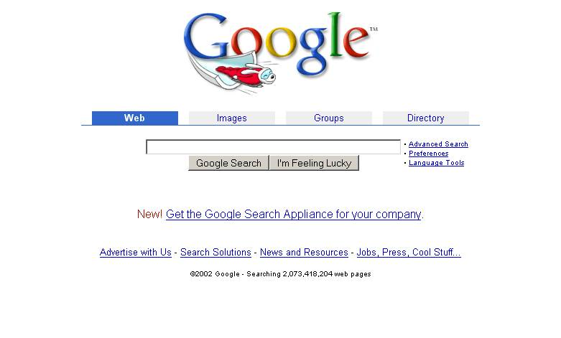
Google 2002
Notes:
Let’s go back a few years, do you prefer Google 2002?

Slide 19
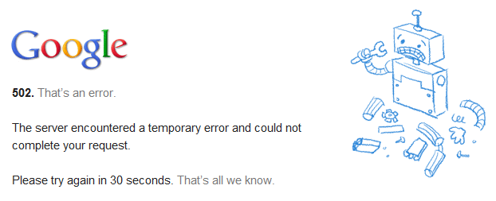
Google 502
Notes:
Or do you prefer Google 502?
So do we prefer the latest feature or the product works?

Slide 20
Reliability is taken for granted!
Till something bad happens.
Notes:
It’s not thought about really until there’s reliability issues and easily taken for granted.
Characterized based on absence of errors.
By the time a service is unstable a series of systems failures have occurred.
We need to work on reliability all the time, not just when it’s on fire.

Slide 21
Do we want 100% reliability?
Notes:
On the flip side, do we want 100% reliability though?
Is it achievable?
One way I could achieve this is to freeze source control, stop builds and stop production deployment and only essential PROD maintenance
/ care taking such as disk space increases, etc.

Slide 22
No!
Notes:
We need SREs in order to embrace risk! SREs shouldn’t actually be trying to avoid all outages. Instead sometimes they can be ones pushing for risk at times if the error budget allows it based on the SLO.
Service Level Objectives (SLOs) is a target value or range for a service level that is measured by a SLO.
Google have a loosely coupled distributed lock system called Chubby and is designed is for availability and reliability as opposed to high performance. They found that failures in the global Chubby service consistently resulted generated service outages, many of which were end user visible. This is because of its high availability rate (and hardly even had true global outages), it provided a false sense of security so people started adding dependencies assuming it would never go down. The solution was for SREs to ensure Chubby meets but does not significantly exceed it’s SLO. For any given quarter if a true failure has not dropped availability below the target, a controlled outage will be initiated by intentionally taking the service down. This allows them to flush out unreasonable dependencies. Doing so forces service owners to reckon the reality of distributed systems soon rather than later.

Slide 23
What does it take to make a service reliable?

Slide 24
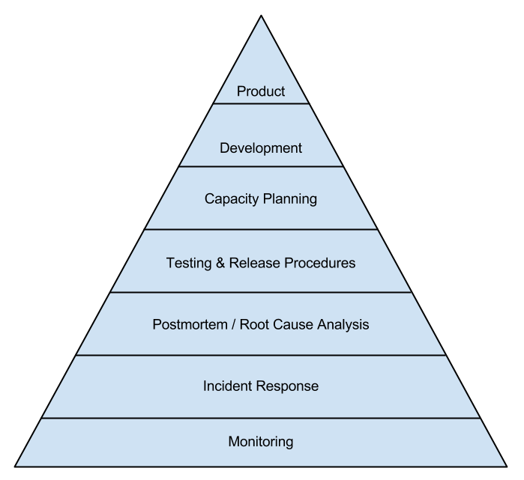
Notes:
Reliability pyramid - Think of it as building blocks and practices required for SRE.

Slide 25
Monitoring
Notes:
Building block underpins all our efforts and other stages. Without solid monitor we’d be flying blind and unable to detect outages.
This is where SLO come into play as they need monitoring.
It’s both unrealistic and undesirable to insist that SLOs will be met 100% of the time: doing so can reduce the rate of innovation and deployment. Instead, it is better to allow an error budget—a rate at which the SLOs can be missed—and track that on a daily or weekly basis. These are what are reported to Upper management on a monthly or quarterly assessment, too. (An error budget is just an SLO for meeting other SLOs!)
Outputs of monitoring should be alerts, tickets, logging.

Slide 26
Incident Response
Notes:
Required formal incident response for outages, which is followed.
Communication of incidents is key.
Incident response is not about find root cause, it’s about restoring reliability and functionality. Can also mean gracefully degrading user experience temporarily using feature toggles. Essentially stopping the bleed.

Slide 27
Postmortem / Root Cause Analysis
Notes:
This comes after we’ve mitigated the impact. Why - Because the intent is that we be alerted on and manually solve only new and exciting problems; it’s boring fixing same thing again.
Postmortem enabled that the feedback.
A postmortem must always include actionable items to detect the issue more effectively and prevent the issue in the future if possible.

Slide 28
Postmortems are learning opportunities and should be blameless.
Notes:
Even though it might sometimes be hard to be blameless, we should trust SREs and engineers tried their best.

Slide 29
“Fail fast, learn quickly, and move forward!”
Notes:
Motto I’ve adopted for our postmortems.

Slide 30
Testing & Release Procedures
Notes:
Knowing what goes wrong, our next step is to attempt to prevent it by writing our test suits to give us assurance and confidence that our services are doing as we expected with issue before released to production.
Use of unit tests, integration tests, acceptance tests, systems integration tests, smoke tests.
If you find an issue, you need good release procedures in order to either roll forward or back.

Slide 31
Capacity Planning
Notes:
Capacity planning is key so we can scale out before we run into reliability issues as well as ensuring we’re using capacity already provisioned.
Need to be able to deal with current workload and expected growth.
As part of this stage, we might also want to think about how we handle overload and addressing cascade failures. These can be if one instance fails, it will put pressure on other instances and cause them to overload and fail. Could also include load shedding.

Slide 32
Development
Notes:
A service doesn’t become reliable overnight. It takes effort, including development. This is why SREs must be able to code on the application along side normal developers so they can help out, with a focus on supportability.

Slide 33
Product
Notes:
Now we have a product that has been built with reliability which we need to launch.
At Google they have Launch Coordination Engineers within the Site Reliability Team who have a launch checklist of common questions to ask about a launch and solutions to common issues.

Slide 34

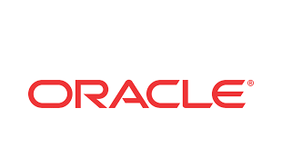







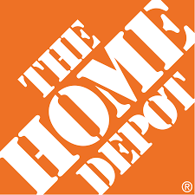



























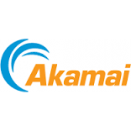
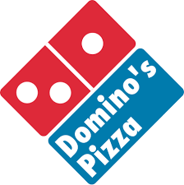




















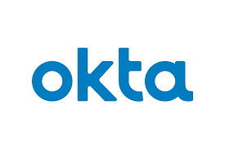








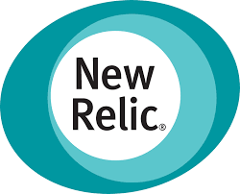





Notes:
What do all these companies have in common? They’ve implemented SRE / production engineers.

Slide 35
What do we need to make SRE a success?
Appropriate access
Continued management buy-in
Empowering SREs
Hard work
You!
Notes:
SOX is ok with SRE having appropriate operations access, long as monitored, logged and alerted upon.
Continued management buy-in - ensuring no conflict of interest.
Hard work - it won’t be easy but together we can really make some change.

Slide 36
“Hope is not a strategy”
Notes:
Closing words. Hope is not a strategy. we must work to make Site Reliability Engineering a success. As Mary P said too, reliability is hard.
Quote by Ben Treynor
Speak to me if you have any questions.

Slide 37

Thank you!
Ashley Poole
@AshleyPooleUK
https://ashleypoole.co.uk

